Slide 1




Houston Astros Consulting Strategy - Team 19
Asrith, Bhavik, Nikhil, Prajay

Slide 2
Roadmap
01
02
03
Filtering Data
Machine Learning Model
Free Agency
Recommendations
Consolidating data and pinpointing relevant statistics
Developing training and testing data to make predictions
Bidding strategy based on subjective analysis and machine learning

Slide 3


Filtering
Data
Filtered batting_season_summary to only retain the data of free agents
Made a variable “total” that sums first, second, third base, and home runs
Sorted by year in descending order
Created a roster view of the 2023 Astros through filtering batting_season_summary

Slide 4
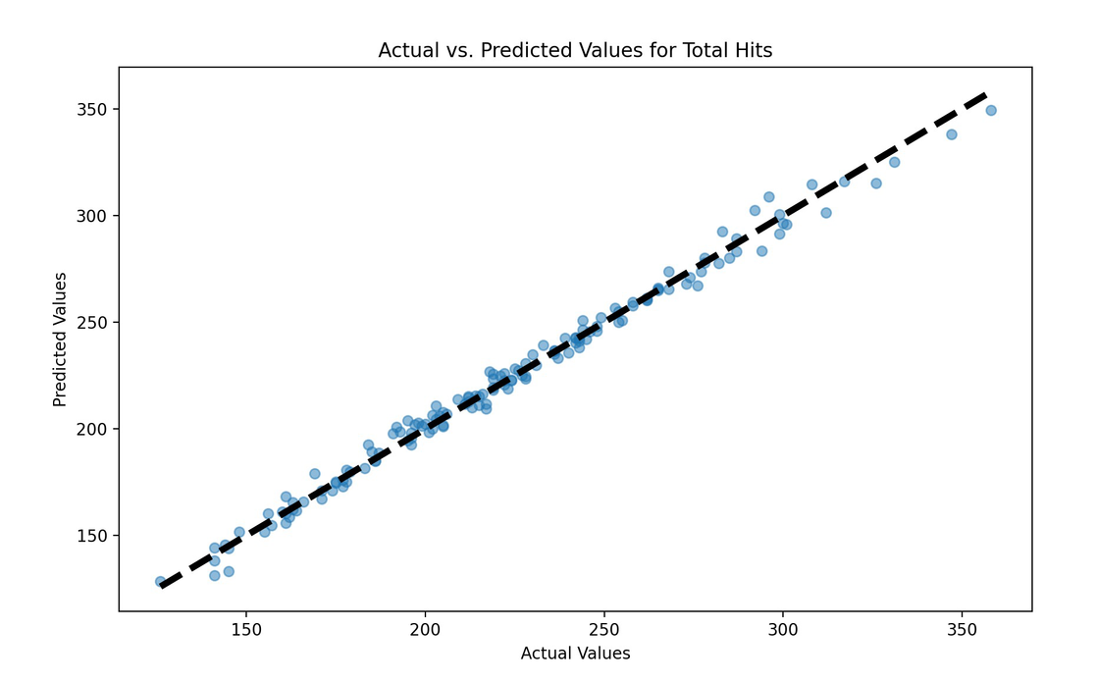
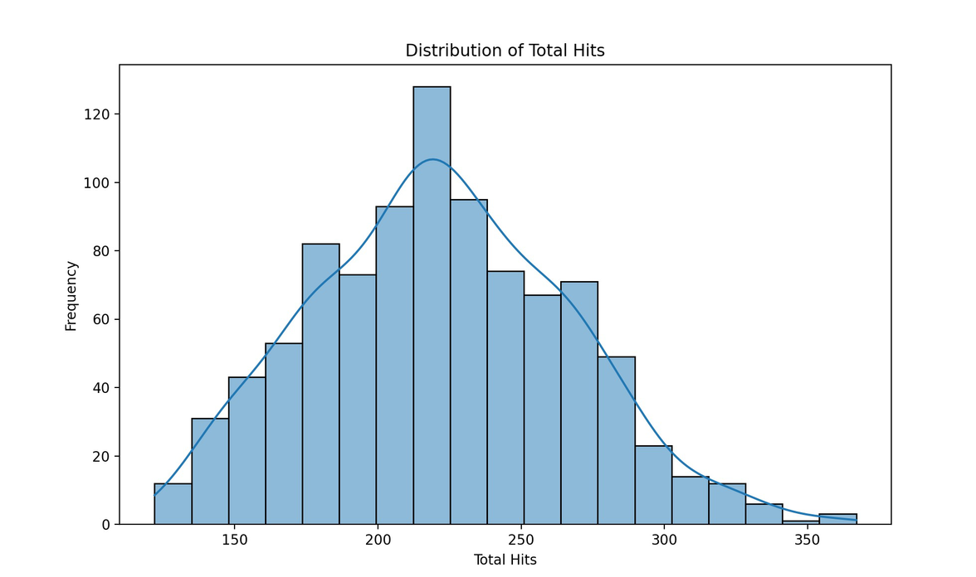
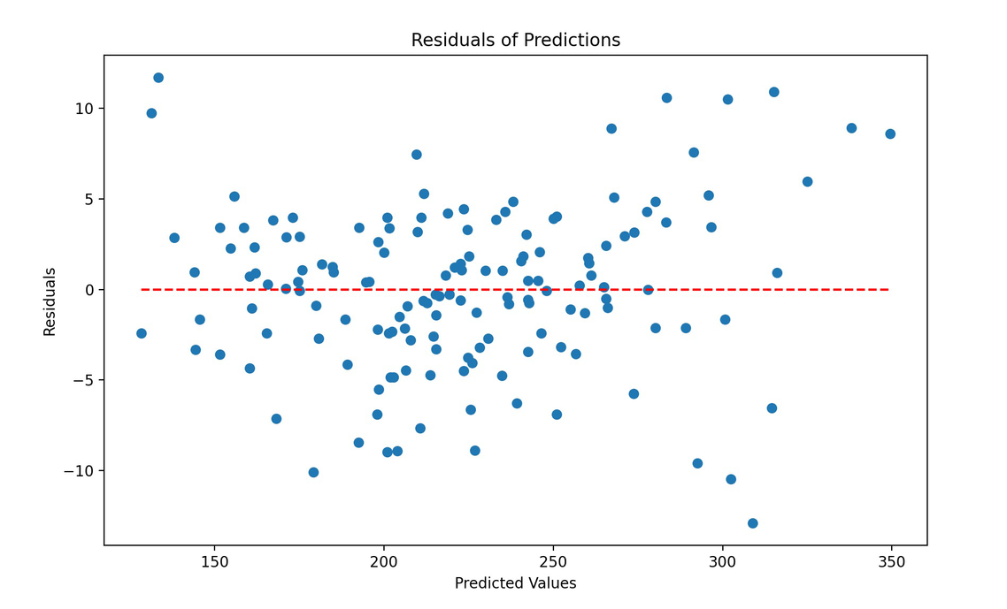
Developing the Model
SCIKIT LEARN (LINEAR REGRESSION MODEL) WITH SCALING - PRINCIPAL COMPONENT ANALYSIS
TRAINING DATA = 80% OF PAST DATA (2014-2021 PLAYER DATA)
TESTING DATA = REMAINING 20% (2022-2023)
WEIGHTED BY YEAR AND AGE FROM PRIME
EVALUATION: RMSE & R-SQUARED VALUES
Notes:
. Data Loading and Preprocessing:
We start by loading our filtered dataset using pandas, which contains information about baseball players and their performance metrics.
The dataset is then split into training and testing sets based on a cutoff year, ensuring temporal consistency in our evaluation.
We specify the features (attributes) that we'll use to predict the target variable, which in this case, is the total number of hits ('total').
2. Feature Engineering:
We assign weights to each year, giving higher weights to more recent years.
Additionally, we identify each player's prime year and assign higher weights to those years.
These weights are combined to create sample weights, which will be used during model training.
3. Model Building:
We construct a pipeline that includes data preprocessing steps such as scaling and dimensionality reduction using PCA (Principal Component Analysis), followed by a linear regression model.
PCA helps in reducing the dimensionality of our feature space while retaining most of its variance.
4. Model Training and Evaluation:
The model is trained using the training set while incorporating sample weights.
We evaluate the model's performance on the test set using metrics like RMSE (Root Mean Squared Error) and R-squared.
5. Predictions for Next Year:
We use the trained model to predict the expected number of hits for the next season for each player in the test set.
Bottom right: This histogram shows the distribution of the total hits across all players and seasons in your dataset. A well-distributed target variable suggests that the linear regression model can capture the variance effectively without transformations.
Top right: This scatter plot compares the actual total hits against the predicted values. A close alignment along the dashed line (indicating perfect predictions) suggests high model accuracy.
Bottom left: No pattern in resiodual plot which shows that it is an accurate model and

Slide 5



Bidding Strategy
WAR FACTORIZATION
POSITIONAL VALUE
PITCHING NEEDS

